Slide 1
Project : 9
Deep Learning for Musculoskeletal Dynamics and Transformation Approximation

Slide 2
Table of contents
01
02
03
Approach
Objectives
Problem Statement
04
05
06
Methodology
Analysis
Conclusions
You can describe the topic of the section here
You can describe the topic of the section here
You can describe the topic of the section here
You can describe the topic of the section here

Slide 3
01
Problem statement
Deep Learning for Musculoskeletal Dynamics and Transformation Approximation is essential for modeling biomechanical movements in prosthetics and human-machine interfaces. Traditional methods struggle with complex, nonlinear relationships between joint angles, muscle lengths, and moment arms. This study explores Artificial Neural Networks (ANN) to achieve accurate, low-cost, real-time musculoskeletal modeling.

Slide 4
The Approach
02
Progress
1
2
3
A musculoskeletal model generated input-output datasets to train an Artificial Neural Network (ANN) for transformation approximation. The ANN was developed using supervised learning, optimizing hyperparameters for accuracy and efficiency
Data
Model
Evaluation
Data Generation & Preprocessing
Model Development & Training
Evaluation & Performance Analysis
Steps

Slide 5
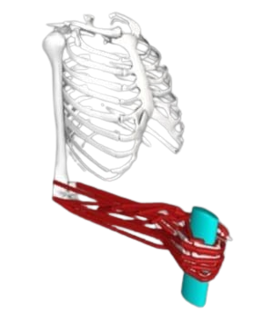
ARMS Hand & Wrist Model
03
1. Realistic Joint Movements (23 Degrees of Freedom)
Fingers and Thumb: Can bend (flexion/extension) and spread apart (abduction/adduction).
Thumb Joint: Moves in multiple directions, allowing it to touch other fingers.
Wrist: Moves up and down (flexion/extension) and side to side (radial/ulnar deviation).
Natural Coupling: Some finger joints are linked, just like in a real hand.

Slide 6
2. Passive Joint Motion (Automatic Natural Movement)
The model includes built-in joint stiffness and flexibility, so when no force is applied, it still behaves like a real hand.
It can copy a natural hand movement called tenodesis, where the fingers automatically open when the wrist moves up.
3. Muscle Simulation (43 Muscles Included)
Intrinsic Muscles
Extrinsic Muscles
Wrist Muscles
4. Simulates Real-Life Hand Functions
Grip strength (holding objects firmly).
Pinch strength (holding small items between fingers).
Active hand opening (using muscles to open the hand).

Slide 7
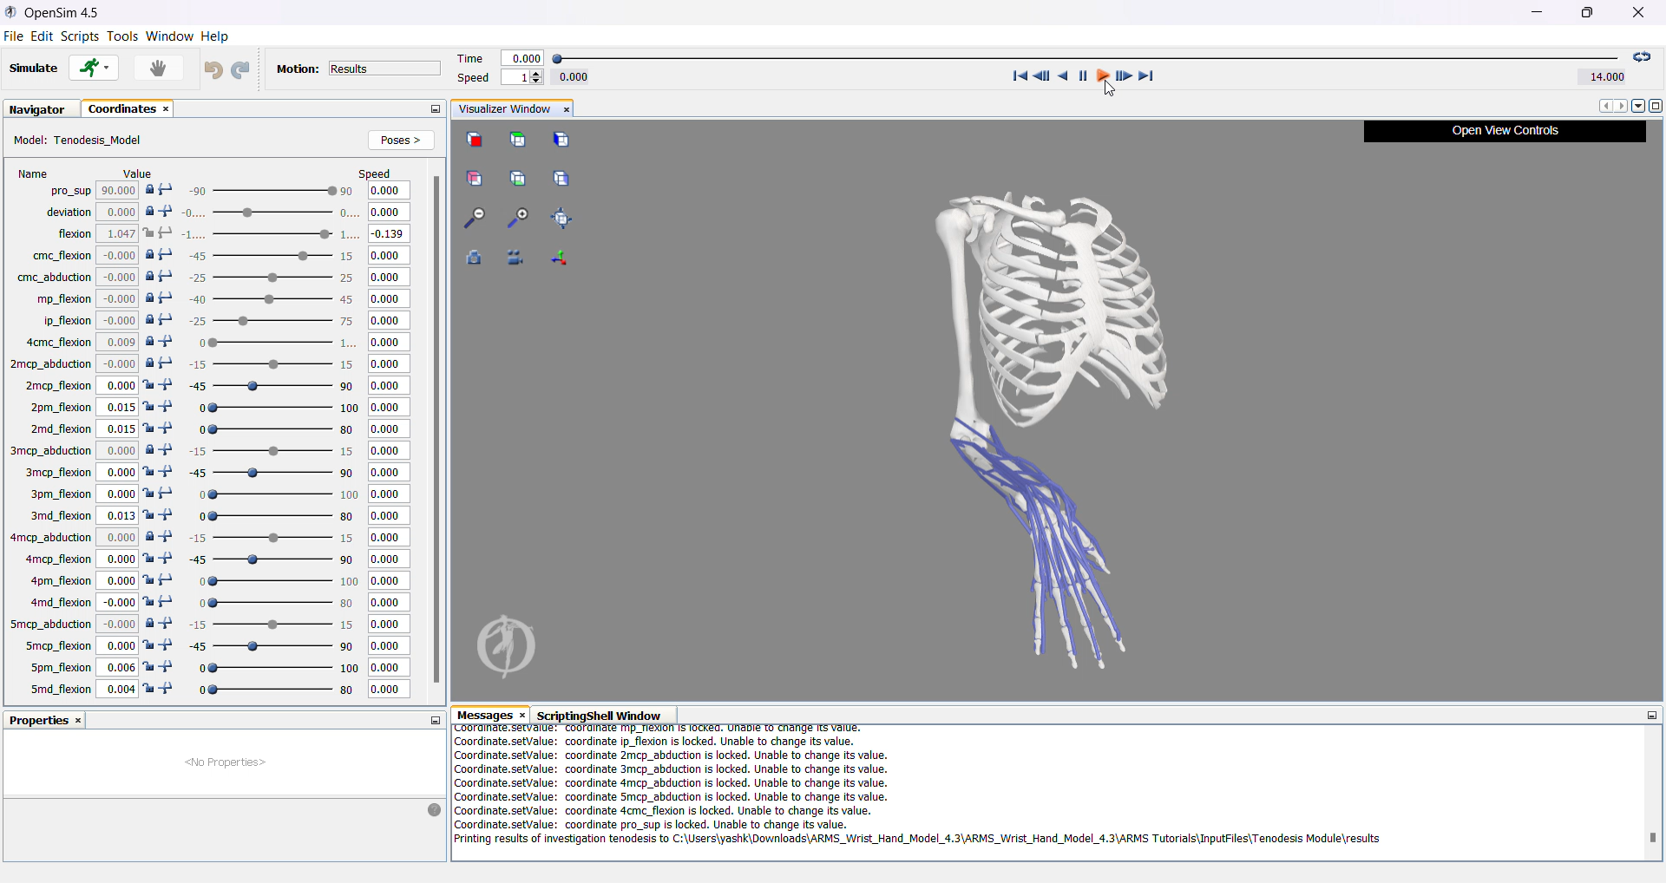
Data Set Generation
04
Data Usage Summary:
Generated: 1,000,000 (10 lakh) data points
Utilized: 30,000 data points

Slide 8
ANN Model Overview
05
Model Type:
Artificial Neural Network (ANN)
Input Data:
18 joint angles as input features
Muscle Length Model: 33 muscle lengths as targets
Moment Arm Model: 60 moment arms as targets
Architecture:
🔹 Muscle Length Model
Hidden Layers: 1024 → 512 (ReLU)
Output Layer: 33 neurons (Linear)

Slide 9
🔹 Moment Arm Model
Hidden Layers: 2048 → 1024 (ReLU)
Output Layer: 60 neurons (Linear)
Training Details:
Optimizer: Adam (LR = 0.001)
Loss Function: MSE
Early Stopping: Patience = 5
Epochs: 50, Batch Size: 256
Results:
🔹 Muscle Length Model:
MSE: 0.000025, MAE: 0.002120

Slide 10
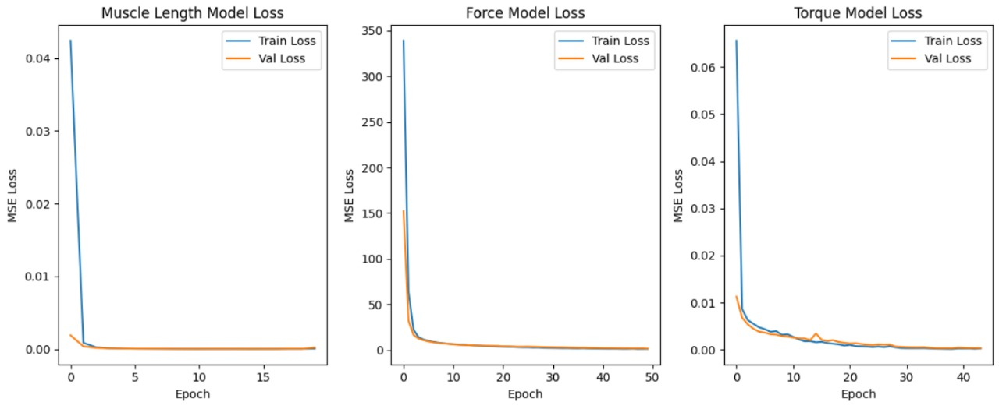
🔹 Force Model:
MSE: 1.202641, MAE: 0.219427
🔹 Torque Model:
MSE: 0.000389, MAE: 0.004484

Slide 11
What we plan to do next
06
Use LSTM/RNN for Better Performance
Use GPU for Faster Training
Collect and preprocess larger datasets to improve model robustness and accuracy.

Slide 12
Thanks

